Slide 1
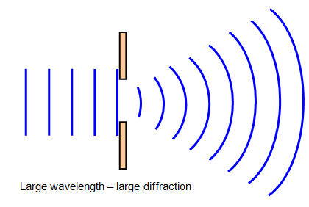
Quiz 5 Review
When light, sound, or heat hit a surface that it can’t pass through:
The picture below shows:
The picture to the right shows:
Reflection
Diffraction
Refraction

Slide 2
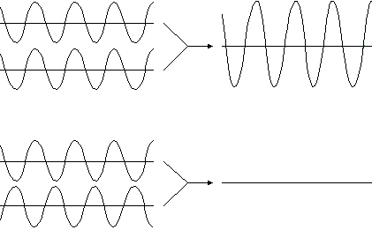
Quiz 5 Review
What are the 2 types of wave interference?
Constructive interference __________ the amplitude.
Destructive interference ___________ the amplitude.
From the picture below, which wave interaction is destructive?
Constructive
Destructive
increases
decreases

Slide 3
Quiz 5 Review
Which travels faster, light or sound?
Sound travels fastest through ______
Sound travels slowest through _____
From the picture below, which wave interaction is constructive?
Light
solids
gases

