Slide 1
Quiz 4 Review
Waves transfer _______
Mechanical waves travel through _________________
_________________ waves travel through space, require no matter
List 2 examples of mechanical waves
List 2 examples of electromagnetic waves
As a wave travels, it’s energy ____________
energy
matter (medium)
Electromagnetic
water
air
sound
UV light
visible light
microwaves
spreads out

Slide 2
Quiz 4 Review
Mechanical waves can be both ___________ or _____________
Electromagnetic waves can be only ___________
The physical environment that a wave travels through.
Electromagnetic waves can travel through ________ and ______
Mechanical waves can travel through _________
transverse
longitudinal
transverse
medium
medium
space
medium

Slide 3
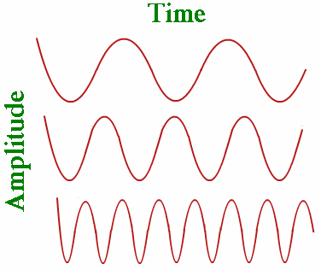
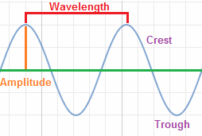
Quiz 4 Review
Highest frequency?
Label wavelength, amplitude, and crest
wavelength
crest
amplitude

